Slide 1
Type of Models

Slide 2
Type of Models
Models
PHYSICAL
MATHEMATICAL
STATIC
DYNAMIC
STATIC
DYNAMIC
NUMERICAL
ANALYTICAL
NUMERICAL
SYSTEM SIMULATION

Slide 3
Physical models are based on some analogy between such systems as mechanical and electrical. In a Physical model of a system, the system attributes are represented by such measurements as a voltage or the position of a shaft. The system activities are reflected in the physical laws that drive the model.
Mathematical models use symbolic notation and mathematical equations to represent a system. The system attributes are represented by variables, and the activities are represented by mathematical functions that interrelate the variables.

Slide 4
Static Models can only show the values that system attributes take when the system is in balance.
Dynamic models follow the changes over time that result from the system activities.
Applying analytical techniques means using the deductive reasoning of mathematical theory to solve a model.
Numerical methods involve applying computational procedures to solve equations.
System Simulation is considered to be a numerical computation technique used in conjunction with dynamic mathematical models.

Slide 5
Static Physical Models :
The best known examples of physical models are scale models. In shipbuilding, making a scale model provides a simple way of determining the exact measurements of the plates covering the hull, rather than having to produce drawings of complicated, three-dimensional shapes.
Scientists have used models in which spheres represent atoms, and rods or specially shaped sheets of metal connect the spheres to represent atomic bonds. A model of this nature played an important role in the deciphering of the DNA molecule, work that was the subject of a Nobel prize award. These models are static physical models. They are sometimes said to be iconic models, a term meaning "look-alike".

Slide 6
Scale models are also used in wind tunnels and water tanks in the use of designing aircraft and ships. Although air is blown over the model, or the model is pulled through the water, these are static physical models because the measurements that are taken represent attributes of the system being studied under one set of equilibrium conditions. In this case, the measurements do not translate directly into system attribute values. Well known laws of similitude are used to convert measurements on the scale model to the values that would occur in the real system.
Sometimes, a static physical model is used as a means of solving equations with particular boundary conditions. There are many examples in the field of mathematical physics where the same equations apply to different physical phenomena. For example, the flow of heat and the distribution of electric charge through space can be related by common equations.

Slide 7
Dynamic Physical Models :
Dynamic physical models rely upon an analogy between the system being studied and some other system of a different nature, the analogy usually depending upon an underlying similarity in the forces governing the behavior of the systems. . To illustrate this type of physical model, consider the two systems showing in the Figure.

Slide 8
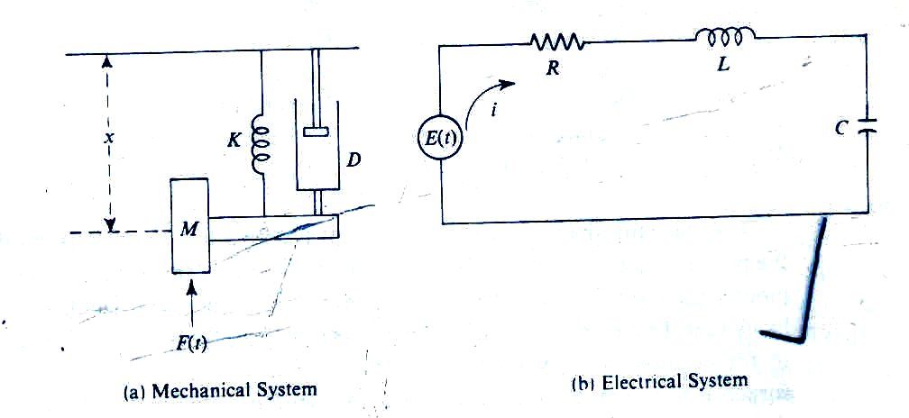

Slide 9
Figure (a) represents a mass that is subject to an applied force F(t) varying with time, a spring whose force is proportional to its extension or contraction, and a shock absorber that exerts a damping force proportional to the velocity of the mass. The system might, for example, represent the suspension of an automobile wheel when the automobile body is assumed to be immobile in a vertical direction. It can be shown that the motion of the system is described by the following differential equation:3
Mx + Dx + Kx =KF(t)
Where x is the distance moved,
M is the mass
K is the stiffness of the spring
D is the damping factor of the shock absorber.

Slide 10
Static Mathematical Models :
A static model gives the relationships between the system attributes when the system is in equilibrium. If the point of equilibrium is changed by altering any of the attribute values, the model enables the new values for all the attributes to be derived but does not show the way in which they changed to their new values.
For example, in marketing a commodity there is a balance between the supply and demand for the commodity. Both factors depend upon price: a simple market model will show what is the price at which the balance occurs.

Slide 11
Demand for the commodity will be low when the price is high, and it will increase as the price drops. The relationship between demand, denoted by Q, and price, denoted by P, might be represented by the straight line.
On the other hand, the supply can be expected to increase as the price increases, because the suppliers see an opportunity for more revenue. Suppose supply, denoted by S, is plotted against price, and the relationship is the straight line.
If conditions remain stable, the price will settle to the point at which the two lines cross, because that is where the supply equals the demand.

Slide 12
Since the relationships have been assumed linear, the complete market model can be written mathematically as follows:
Q = a – b*P
S = c + d*P
S=Q
The last equation states the condition for the market to be cleared; it says that supply equals demand and so, determines the price to which the market will settle.

Slide 13
Dynamic Mathematical Models :
A dynamic mathematical model allows the changes of system attributes to be derived as a function of time. The derivation may be made with an analytical solution or with a numerical computation, depending upon the complexity of the model. The equation that was derived to describe the behavior of a car wheel is an example of a dynamic mathematical model; in this case, an equation that can be solved analytically.
It is customary to write the equation in the form
x + 2cwx + w²x = w²F(t)
where 2cw = D/ M and w² = K/ M.

